Slide 1
Chapter 6 Linear Models: 2-Way ANOVA
Beckerman et al. p. 131-144;

Slide 2
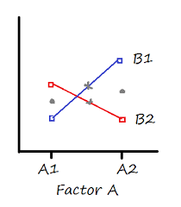
Extend Linear Models to Multiple Predictors
The two-way ANOVA corresponds to data that have structure in two dimensions.
The response variable may vary with both predictor variables.
Experiments associated with a two-way ANOVA investigate how the response varies with one variable and may depend on the other variable.
This is a statistical interaction.

Slide 3
Extend Linear Models to Mult. Predictors
The two grey dots indicate the main effect means for Factor A. Their height is pretty much the same, so there would be no main effect for Factor A.
The two grey Xs indicate the main effect means for Factor B. Sure, the B1 mean is slightly higher than the B2 mean, but not by much. In most data sets, this difference would not be significant.
But there clearly is an interaction. The difference in the B1 means is clearly different at A1 than it is at A2 (one difference is positive, the other negative).

Slide 4
Extend Linear Models to Mult. Predictors
You’d say there is no overall effect of either Factor A or Factor B, but there is an interaction.
The effect of B on the response variable is opposite, depending on the value of Factor A. (contingent inference; depends on…)
If there is evidence of a significant interaction between A and B, comparisons of the mean treatment responses for A must be conducted separately for each level of B, because the differences in the treatment mean responses across the levels of A may differ, depending on the level of B.
Notes:
Wei et al 2012.

Slide 5
A two-way ANOVA with interaction tests three statistical null hypotheses at the same time:
There is no difference in group means at any level of the first independent variable.
There is no difference in group means at any level of the second independent variable.
The effect of one independent variable does not depend on the effect of the other independent variable (a.k.a. no interaction effect).
A two-way ANOVA without interaction (a.k.a. an additive two-way ANOVA) only tests the first two of these hypotheses.

Slide 6
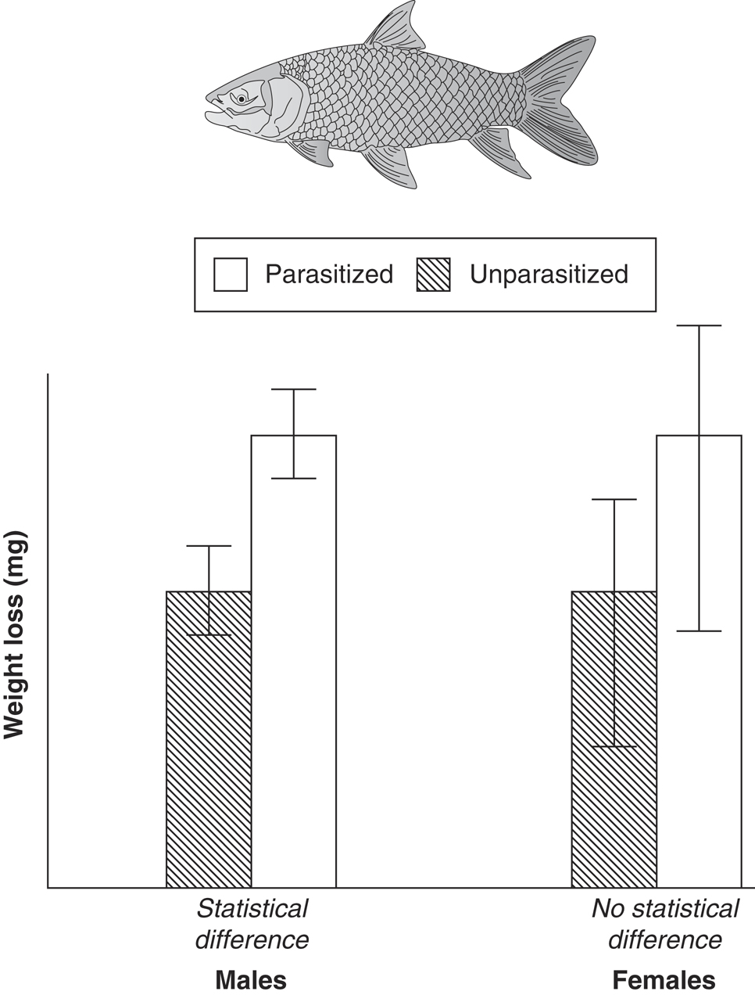
More on Interactions
Example Two-factor Experiment
Infection Status (parasites–no parasites) = Factor 1
Sex (male–female) = Factor 2
Weight loss = response variable to estimate the costs of parasitism.
Cannot just conduct two one-way experiments (comparing males and females separately) because the hypothesis was about the interaction.
The reason this would be wrong is that the researcher has only tested for main effects of parasitism, but not the interaction between parasitism and sex.
By doing separate tests, the researcher has looked at the difference in male fish caused by the parasites but has not directly compared the difference in male fish to the difference in female fish (reference group).
Looking at the graphs, there is no good evidence for a difference in the way males or females respond to parasitism. (no evidence of interaction)
If the researcher does not test for the interaction, the conclusion would have been that parasitized males lost more body weight than unparasitized; erroneous (incomplete) conclusion. Parasitized males lose no more mass than parasitized females.
Mean and SE of weight loss in fish, separated by sex and parasitism status

Slide 7
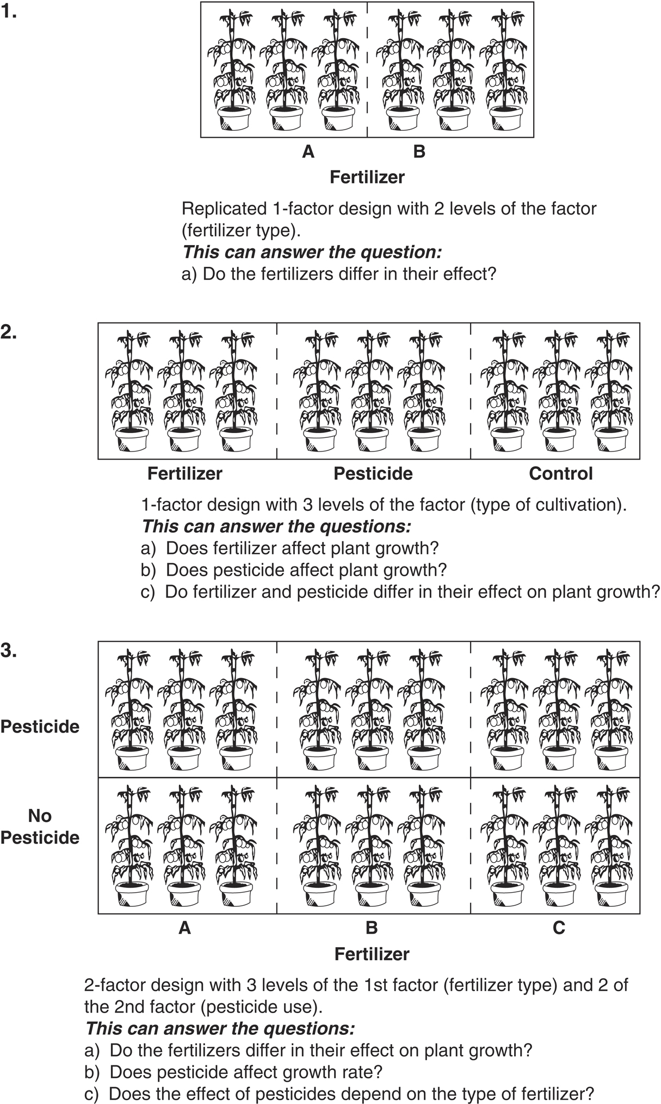
Experimental designs that consider both main effects and interaction effects allow more nuance into how a system functions.
Main Effect
Main Effect(s)
Notes:
Because sometimes we are interested in the interaction explicitly.
Also run into family-wise error rate issues (need to correct for that)

Slide 8
Main Effects and Interaction Effects
Why not just do two different one-way experiments?
P-values are multiplicative.
Notes:
Because sometimes we are interested in the interaction explicitly.
Also run into family-wise error rate issues (need to correct for that)

Slide 9
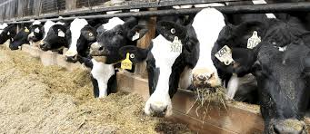
Example from Assigned Reading: Cow Growth Data
Cows fed one of three diets; barley, oats, wheat
Diets enhanced with one of four supplements
Data are from a fully factorial experimental design, where each combination of diet and supplement was replicated three times. (balanced)
This means that there are three diets X four supplements = 12 treatment combinations, each with three cows in them (36 times).

Slide 10
Cow Growth Data
growth.moo <- read_csv("growth.csv")
glimpse(growth.moo)
#Rows: 48
#Columns: 3
#$ supplement <chr> "supergain", "supergain", "supergain", "supergain", "control", "contr…
#$ diet <chr> "wheat", "wheat", "wheat", "wheat", "wheat", "wheat", "wheat", "wheat…
#$ gain <dbl> 17.37125, 16.81489, 18.08184, 15.78175, 17.70656, 18.22717, 16.08650,…
# It doesn’t that know that diet and supplement should be
# considered as factors (some packages can still deal with it as is)
growth.moo$diet <-as.factor(growth.moo$diet)
growth.moo$supplement < as.factor(growth.moo$supplement)

Slide 11
Cow Growth Data
glimpse(growth.moo) # diet and supplement should be factors now
levels(growth.moo$diet)
# [1] "barley" "oats" "wheat"
levels(growth.moo$supplement)
#[1] "agrimore" "control" "supergain" "supersupp"
One of the things we can immediately see is that the supplements include a control level, but the agrimore level is in front of it alphabetically.
Important to put the control level first (if there is one) because it provides the baseline of comparison in the coefficients table (we saw this before in 1-way ANOVA; same thing here). Otherwise, coefficient comparisons make less intuitive sense.

Slide 12
Cow Growth Data
Here we employ the function relevel(), which creates a new reference level by re-ordering levels of the factor.
We use it with the mutate() function from dplyr:
growth.moo <-
mutate(growth.moo,
supplement = relevel(supplement, ref="control"))
levels(growth.moo$supplement)
## [1] "control" "agrimore" "supergain" "supersupp"

Slide 13
# calculate mean weight gain for all 12 combinations
sumMoo <- growth.moo %>%
group_by(diet, supplement) %>%
summarise(meanGrow = mean(gain))
# make sure it worked
sumMoo
## Source: local data frame [12 x 3]
## Groups: diet [?]
##
## diet supplement meanGrow
## (fctr) (fctr) (dbl)
## 1 barley control 23.29665
## 2 barley agrimore 26.34848
## 3 barley supergain 22.46612
## 4 barley supersupp 25.57530
## 5 oats control 20.49366
…

Slide 14
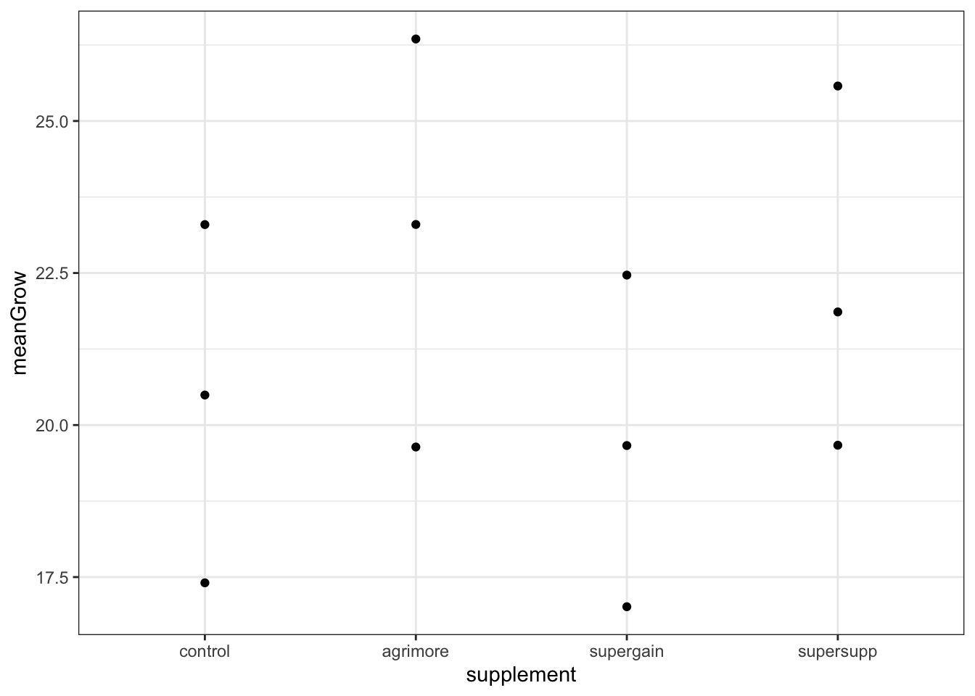
Cow Growth Data
As always, our first step in analysis is a figure:
ggplot(sumMoo, aes(x = supplement, y = meanGrow)) +
geom_point() +
theme_bw()
The effect of supplement type on cow weight gain depends on the diet.

Slide 15
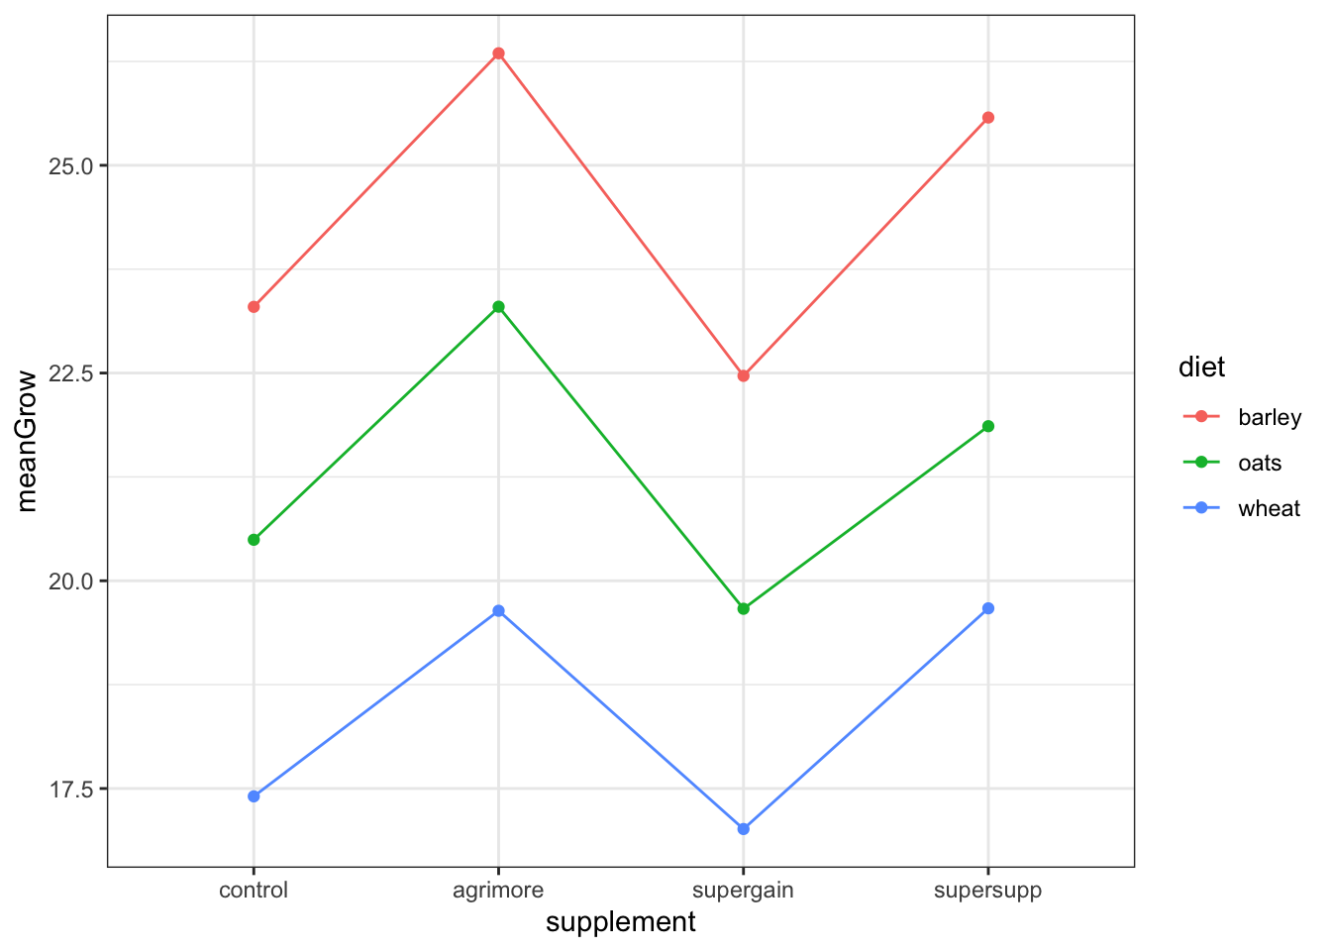
Cow Growth Data
The next step is connecting the dots to visualize the
second factor.
ggplot(sumMoo, aes(x = supplement, y = meanGrow,
colour = diet, group = diet)) +
geom_point() +
geom_line() +
theme_bw()
Does the effect of supplement type on cow weight gain depend on the diet?

Slide 16
Cow Growth Data
Both diet and supplement type seem to have an effect.
Build a model to test both main effects, and their interaction.
model_cow <- lm(gain ~ diet * supplement, data = growth.moo)
This says “test the hypothesis that weight gain is a function of diet, supplement, AND their interaction”. (Notice the * notation)
First, examine model assumptions.
autoplot(model_cow, smooth.colour = NA)

Slide 17
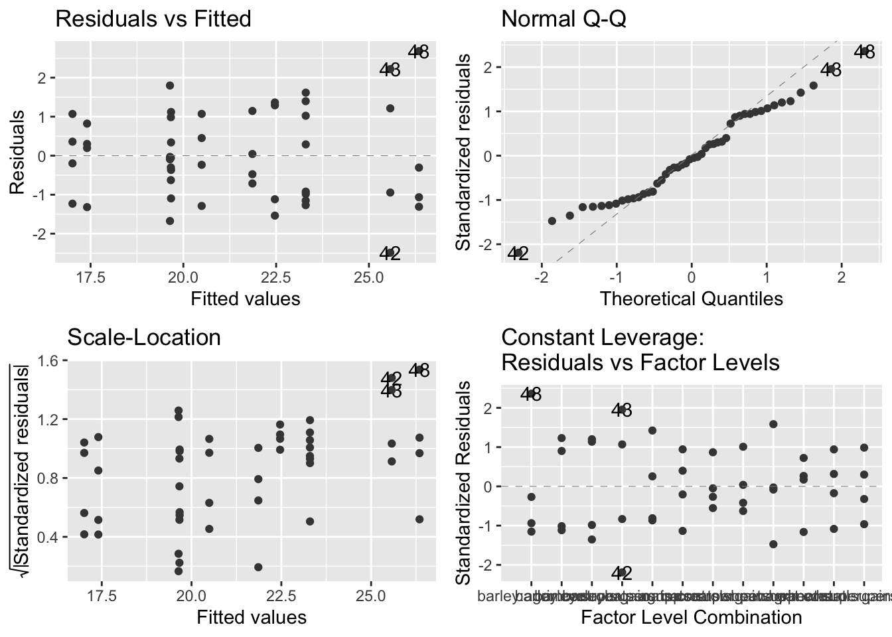
Cow Growth Data
Not great, but no troublesome patterns. The general linear model is quite robust to moderate deviations from normality, so let’s keep going.

Slide 18
Cow Growth Data
anova(model_cow)
## Analysis of Variance Table
##
## Response: gain
## Df Sum Sq Mean Sq F value Pr(>F)
## diet 2 287.171 143.586 83.5201 2.999e-14 ***
## supplement 3 91.881 30.627 17.8150 2.952e-07 ***
## diet:supplement 6 3.406 0.568 0.3302 0.9166
## Residuals 36 61.890 1.719
## ---
## Signif. codes:
## 0 '***' 0.001 '**' 0.01 '*' 0.05 '.' 0.1 ' ' 1
The majority of variation due to diet
143 out of a total of 176.5
Supplement explained 30.6 out of a total of 176.5
Interaction explained 0.57 out of a total of 176.5
using diet*supplement has expanded table to provide three rows, corresponding to the variation explained by diet, the supplement, and the interaction. (:=*)

Slide 19
Results Statement
## Response: gain
## Df Sum Sq Mean Sq F value Pr(>F)
## diet 2 287.171 143.586 83.5201 2.999e-14 ***
## supplement 3 91.881 30.627 17.8150 2.952e-07 ***
## diet:supplement 6 3.406 0.568 0.3302 0.9166
## Residuals 36 61.890 1.719
## ---
## Signif. codes:
## 0 '***' 0.001 '**' 0.01 '*' 0.05 '.' 0.1 ' ' 1
Usually remind the audience of the hypothesis and state the main effects first:
“We tested the hypothesis that the effect of diet supplement on bovine weight
gain depended on cereal diet. We found an influence of diet (F = 83.5; df = 2,36;
P < 0.0001) and supplement type (F = 17.8; df = 3,36; P < 0.0001) on bovine weight gain.
We found no evidence to support the presence of an interaction between diet and
supplement (F = 0.33; df = 6, 36; p = 0.92).” [state the interaction effects last]
Also notice I tried hard to avoid using the word ‘significant’; forces you to focus more
on the effect size (biology) rather than statistical significance.

Slide 20
Cow Growth Data-Summary Table
summary(model_cow)
##
## Call:
## lm(formula = gain ~ diet * supplement, data = growth.moo)
##
## Residuals:
## Min 1Q Median 3Q Max
## -2.48756 -1.00368 -0.07452 1.03496 2.68069
##
## Coefficients:
Estimate Std. Error t value Pr(>|t|)
(Intercept) 23.2966499 0.6555863 35.536 < 2e-16 ***
dietoats -2.8029851 0.9271390 -3.023 0.00459 **
dietwheat -5.8911317 0.9271390 -6.354 2.34e-07 ***
supplementagrimore 3.0518277 0.9271390 3.292 0.00224 **
supplementsupergain -0.8305263 0.9271390 -0.896 0.37631
supplementsupersupp 2.2786527 0.9271390 2.458 0.01893 *
dietoats:supplementagrimore -0.2471088 1.3111726 -0.188 0.85157
dietwheat:supplementagrimore -0.8182729 1.3111726 -0.624 0.53651
dietoats:supplementsupergain -0.0001351 1.3111726 0.000 0.99992
dietwheat:supplementsupergain 0.4374395 1.3111726 0.334 0.74060
dietoats:supplementsupersupp -0.9120830 1.3111726 -0.696 0.49113
dietwheat:supplementsupersupp -0.0158299 1.3111726 -0.012 0.99043
Residual standard error: 1.311 on 36 degrees of freedom
Multiple R-squared: 0.8607, Adjusted R-squared: 0.8182
F-statistic: 20.22 on 11 and 36 DF, p-value: 3.295e-12
Too many post-hoc comparisons (n=66) to interpret all.

Slide 21
Cow Growth-Calculate Mean/SE
# calculate mean and standard error of gain for all 12 combinations
sumMoo <- growth.moo %>%
group_by(diet, supplement) %>%
summarise(
meanGrow = mean(gain),
seGrow = sd(gain)/sqrt(n()))
The standard error of the mean is given by the standard deviation divided by the square root of the sample size, and dplyr provides a function n() that counts the rows in each group.
Be careful…if you have missing values, n() will still count these rows. Must filter NA values before analyses.
Notes:
https://www.statology.org/dplyr-remove-na/
####### this could be helpful ###########

Slide 22
Cow Growth Data-Mean/SE
sumMoo
# A tibble: 12 x 4
# Groups: diet [3]
diet supplement meanGrow seGrow
<fct> <fct> <dbl> <dbl>
1 barley control 23.3 0.703
2 barley agrimore 26.3 0.919
3 barley supergain 22.5 0.771
4 barley supersupp 25.6 1.06
5 oats control 20.5 0.506
6 oats agrimore 23.3 0.613
7 oats supergain 19.7 0.349
8 oats supersupp 21.9 0.413
9 wheat control 17.4 0.460
10 wheat agrimore 19.6 0.710
11 wheat supergain 17.0 0.485
12 wheat supersupp 19.7 0.475

Slide 23
Cow Growth Data-Plot Mean/SE
With this summary table, we can now add three layers to the figure: points, lines, and error bars.
To do this, we use geom_errorbar(), which has its own aesthetics: the lower and upper limits of the vertical lines that we call error bars.
These limits are called ymin and ymax.
Each vertical line is made by placing a line between these limits, passing through meanGrow.

Slide 24
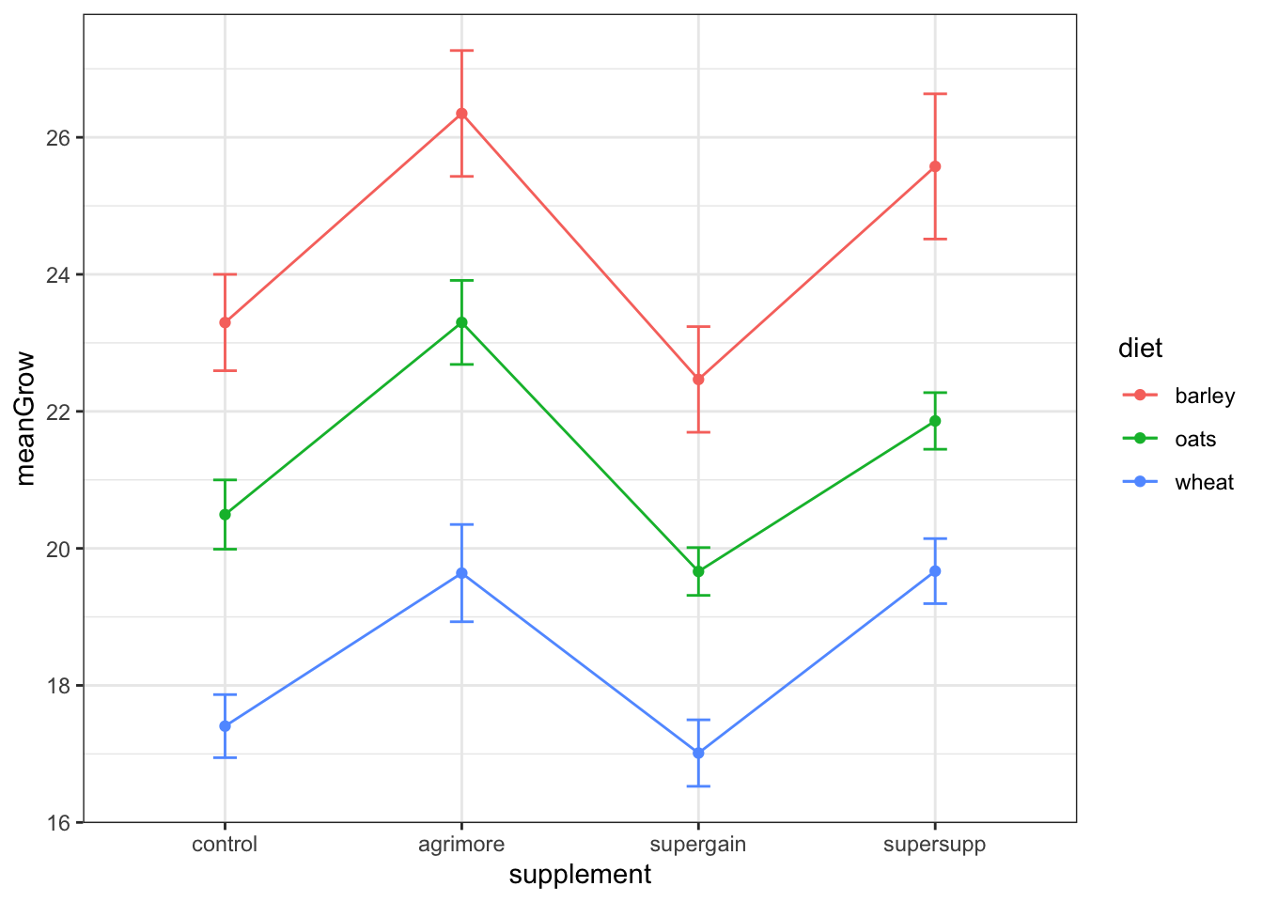
Cow Growth Data-Plot Mean/SE
ggplot(sumMoo, aes(x = supplement, y = meanGrow,
colour = diet, group = diet)) +
geom_point() +
geom_line() +
geom_errorbar(aes(ymin = meanGrow - seGrow,
ymax = meanGrow + seGrow), width = 0.1) +
theme_bw()

Slide 25
What about post-hoc tests like the CLD comparisons we did in 1-WAY ANOVA?
These are slightly different because now they are in context of the interaction.
Zar (1999; 4th Ed. p. 244) Biostatistical Analysis. “If there is a significant interaction between the two factors (in a 2-way ANOVA) , then the means of factor levels should not be compared. Instead, multiple comparison testing may be performed among cells”
Cells under this definition are the combinations of levels of the 2 factors (diet * supplement)
Recall the p-value for the interaction between diet and supplement was 0.91. OK to compare means of factor levels.

Slide 26
Post-hoc Comparisons after 2-Way ANOVA
For the diet variable
emmeans(model_cow, pairwise ~ diet)%>%
multcomp::cld(Letters=letters) %>%
arrange(diet) #so order matches our re-order with control first
#diet emmean SE df lower.CL upper.CL .group
#barley 24.4 0.328 36 23.8 25.1 c
#oats 21.3 0.328 36 20.7 22.0 b
#wheat 18.4 0.328 36 17.8 19.1 a
#Results are averaged over the levels of: supplement Confidence level used: 0.95 P #value adjustment: tukey method for comparing a family of 3 estimates significance #level used: alpha = 0.05
All marginal means for ‘diet’ are different from one another
on a pairwise basis

Slide 27
Post-hoc Comparisons after 2-Way ANOVA
For the supplement variable
emmeans(model_cow, pairwise ~ supplement)%>%
multcomp::cld(Letters=letters) %>%
arrange(supplement) #so order matches our re-order with control first
#supplement emmean SE df lower.CL upper.CL .group
#control 20.4 0.379 36 19.6 21.2 a
#agrimore 23.1 0.379 36 22.3 23.9 b
#supergain 19.7 0.379 36 18.9 20.5 a
#supersupp 22.4 0.379 36 1.6 23.1 b
#Results are averaged over the levels of: diet Confidence level used: 0.95 P value #adjustment: tukey method for comparing a family of 4 estimates significance level #used: alpha = 0.05
Two groups of significant comparisons for ‘supplement’ on a pairwise basis.

Slide 28
Results Statement
Recap Overall Results:
“We tested the hypothesis that the effect of diet supplement on bovine weight gain depended on cereal diet. We found an influence of diet (F = 83.5; df = 2,36; P < 0.0001) and supplement type (F = 17.8; df = 3,36; P < 0.0001) on bovine weight gain. We found no evidence to support the presence of an interaction between diet and supplement (F = 0.33; df = 6, 36; p = 0.92).”
Recap Pairwise Comparisons:
“Means for the diet treatment differed from one another on a pairwise basis, and the control group and supergain supplements produced less growth than the agrimore or supersupp supplements.”
(For now, no need to compare combinations of diet * supplement; this changes a lot when we have sig. vs. non-sig. interaction)

Slide 29
2-Way ANOVA-Elevated CO₂ Example
?CO2 for background information
http://en.wikipedia.org/wiki/Echinochloa_crus-galli
The CO₂ data frame has 84 rows and 5 columns of data from an experiment on the cold tolerance of the grass species Echinochloa crus-galli.
The CO₂​ uptake of six plants from Quebec and six plants from Mississippi was measured at several levels of ambient CO₂​​ concentration.
Half the plants of each type were chilled overnight before the experiment was conducted (half nonchilled).

Slide 30
Plot Data with Boxplot (no summary req.)
ggplot(CO2, aes(Type, uptake, fill=Treatment)) +
geom_boxplot()
#this doesn’t help us visualize significant differences very well

Slide 31
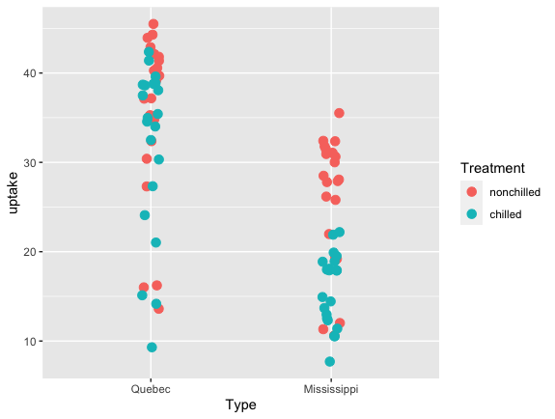
Point Plot with ‘jitter’ (no summary req.)
CO2 %>%
ggplot(aes(x = Type, y = uptake, colour = Treatment, group = Treatment)) +
geom_jitter(width = .05, size=3)
#this doesn’t help us visualize significant differences very well

Slide 32
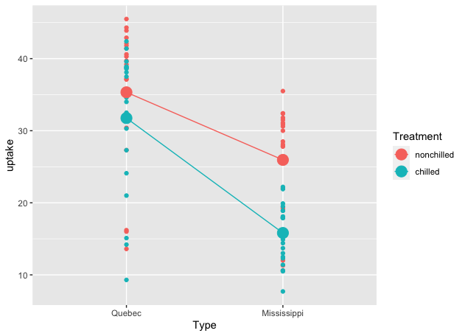
Plot Points (no summary req.)
CO2 %>%
ggplot(aes(x = Type, y = uptake, colour = Treatment, group = Treatment)) +
geom_point() +
stat_summary(fun = mean, geom = "point”, size=5) +
stat_summary(fun = mean, geom = "line")
#this doesn’t help us visualize significant differences very well

Slide 33
data_CO2 <- CO2
summary_CO2 <- data_CO2 %>%
group_by(Type, Treatment) %>%
summarise(mean_uptake=mean(uptake),
n=n(),
se_uptake=sd(uptake)/sqrt(n))
> summary_CO2
# A tibble: 4 × 5
# Groups: Type [2]
#Type Treatment mean_uptake n se_uptake
#<fct> <fct> <dbl> <int> <dbl>
#1 Quebec nonchilled 35.3 21 2.09
#2 Quebec chilled 31.8 21 2.10
#3 Mississippi nonchilled 26.0 21 1.62
#4 Mississippi chilled 15.8 21 0.886
Summarize data before plotting

Slide 34
Plot Using Summary Data and Barchart
plot_CO2 <- ggplot(summary_CO2, aes(x=Type, y=mean_uptake, fill=Treatment)) +
geom_bar(stat="identity", color="black", position=position_dodge()) +
geom_errorbar(aes(ymin=mean_uptake-se_uptake, ymax=mean_uptake+se_uptake), width=.2, position=position_dodge(.9)) +
ylab("CO2 uptake rates (umol/m^2 sec)") +
theme_bw()
plot_CO2

Slide 35
Reformat code if needed…
In Rstudio, you can reformat unwieldy, chunks of code.
- Select the code you want to format
- Code -> Reformat Code
Takes this:
plot_CO2 <- ggplot(summary_CO2, aes(x=Type, y=mean_uptake, fill=Treatment)) +
geom_bar(stat="identity", color="black", position=position_dodge()) +
geom_errorbar(aes(ymin=mean_uptake-se_uptake, ymax=mean_uptake+se_uptake), width=.2, position=position_dodge(.9)) +
ylab("CO2 uptake rates (umol/m^2 sec)") +
theme_bw()

Slide 36
Reformat code if needed…
And changes formatting to this:
plot_CO2 <-
ggplot(summary_CO2, aes(x = Type, y = mean_uptake, fill = Treatment)) +
geom_bar(stat = "identity",
color = "black",
position = position_dodge()) +
geom_errorbar(
aes(ymin = mean_uptake - se_uptake, ymax = mean_uptake + se_uptake),
width = .2,
position = position_dodge(.9)
) +
ylab("CO2 uptake rates (umol/m^2 sec)") +
theme_bw()
Only use if you think it helps you understand the flow of arguments

Slide 37
Plot Data Using Mean +/- SE
plot_CO2_2 <- ggplot(data=summary_CO2, aes(x=Type, y=mean_uptake, group=Treatment, color=Treatment)) +
geom_point(size = 5, position=position_dodge(.25)) + #offsets the point symbols
geom_line(position=position_dodge(.25)) +
geom_errorbar(aes(ymin=mean_uptake-se_uptake, ymax=mean_uptake+se_uptake), width = 0.2, position=position_dodge(.25)) +
theme_bw()
plot_CO2_2

Slide 38
Define Linear Model
model_CO2 <- lm(uptake ~ Type * Treatment, data=data_CO2)
anova(model_CO2) #whether variables in model are significant
#Analysis of Variance Table
#Response: uptake
Df Sum Sq Mean Sq F value Pr(>F)
#Type 1 365.5 3365.5 52.5086 2.378e-10 ***
#Treatment 1 988.1 988.1 15.4164 0.0001817 ***
#Type:Treatment 1 225.7 225.7 3.5218 0.0642128 .
#Residuals 80 5127.6 64.1
#---
#Signif. codes: 0 ‘***’ 0.001 ‘**’ 0.01 ‘*’ 0.05 ‘.’ 0.1 ‘ ’ 1
Sig. effect of Type and Treatment, and borderline sig. effect of the interaction

Slide 39
Summary of Linear Model
summary(model_CO2)
Call:
lm(formula = uptake ~ Type * Treatment, data = data_CO2)
Residuals:
Min 1Q Median 3Q Max
-22.452 -3.624 2.167 5.773 10.648
Coefficients:
Estimate Std. Error t value Pr(>|t|)
(Intercept) 35.333 1.747 20.225 < 2e-16 ***
TypeMississippi -9.381 2.471 -3.797 0.000284 ***
Treatmentchilled -3.581 2.471 -1.449 0.151141
TypeMississippi:Treatmentchilled -6.557 3.494 -1.877 0.064213 .
---
Signif. codes: 0 ‘***’ 0.001 ‘**’ 0.01 ‘*’ 0.05 ‘.’ 0.1 ‘ ’ 1
Residual standard error: 8.006 on 80 degrees of freedom
Multiple R-squared: 0.4718, Adjusted R-squared: 0.452
F-statistic: 23.82 on 3 and 80 DF, p-value: 4.106e-11
Coefficients tell you relative differences among the treatments; most useful part is the
Full-model report (how this model with 3 predictor variables differs from a null model).

Slide 40
Multiple Contrasts Using emmeans
emm_model_CO2 <- emmeans(model_CO2, specs = pairwise ~ Type * Treatment)
emm_model_CO2
$emmeans
Type Treatment emmean SE df lower.CL upper.CL
Quebec nonchilled 35.3 1.75 80 31.9 38.8
Mississippi nonchilled 26.0 1.75 80 22.5 29.4
Quebec chilled 31.8 1.75 80 28.3 35.2
Mississippi chilled 15.8 1.75 80 12.3 19.3
$contrasts
Contrast estimate SE df t.ratio p.value
Quebec nonchilled - Mississippi nonchilled 9.38 2.47 80 3.797 0.0016
Quebec nonchilled - Quebec chilled 3.58 2.47 80 1.449 0.4728
Quebec nonchilled - Mississippi chilled 19.52 2.47 80 7.900 <.0001
Mississippi nonchilled - Quebec chilled -5.80 2.47 80 -2.348 0.0960
Mississippi nonchilled - Mississippi chilled 10.14 2.47 80 4.103 0.0006
Quebec chilled - Mississippi chilled 15.94 2.47 80 6.451 <.0001
Looks to be large and obvious differences between marginal means; in this case marginal means are identical to raw means (those not adjusted for effects in the model)

Slide 41
Connecting Letters Report (all levels)
model_CO2_CLD <- emmeans(model_CO2,
pairwise ~ Type:Treatment,
adjust="tukey")
cld(model_CO2_CLD,
alpha=.05,
Letters=letters) %>%
arrange(Type, Treatment)
Type Treatment lsmean SE df lower.CL upper.CL .group
Quebec nonchilled 35.3 1.75 80 31.9 38.8 c
Quebec chilled 31.8 1.75 80 28.3 35.2 bc
Mississippi nonchilled 26.0 1.75 80 22.5 29.4 b
Mississippi chilled 15.8 1.75 80 12.3 19.3 a

Slide 42
Results Statement
We test the overall hypothesis that carbon uptake is influenced by adaptation to a geographic locality (Quebec or Mississippi) and cold stress (chilled vs. not chilled). We determined that there was an effect of locality type (F_{1,80}=52.5, P < 0.001), effect of cold stress treatment (F_{1,80}=15.4, P < 0.001), but only a borderline interaction effect between the two factors (F_{1,80}=3.5, P = 0.06).
“On a pairwise basis”, ….figure out way to describe pairwise…this takes some finesse.

Slide 43

Practice: Potent Plant Killers
Data (herbicide.csv) are from an experiment, comparing the potency of the two herbicides glyphosate and bentazone in controlling white mustard, Sinapis alba.
White charlock (Sinapis alba) is a Eurasian native, introduced in much of North and South America. Also called white mustard, this species is a very important crop plant, its seeds being the chief ingredient in condiment mustard. It is also grown as a fodder crop and cover crop, but it can be a significant weed of other crops in some regions.
dose_continuous: a numeric vector containing the dose in g/ha.
dose_category: a factor with relative levels of herbicide applied
herbicide: a factor with levels; Bentazone or Glyphosate (the two herbicides applied).
drymatter: a numeric vector containing the response (dry matter in g/pot).

Slide 44

Practice: Potent Plant Killers
Filter the data to include only low and high categorical levels of herbicide.
Is there difference between herbicides and a difference between low and high levels? Is there an interaction between herbicide types and application levels (low and high)?

Slide 45
Not covered:
comparing interaction (multiplicative) vs. additive models
producing minimum adequate model
Helpful Reference:
https://mvanrongen.github.io/corestats-in-r_tidyverse/two-way-anova.html
Notes:
Interaction contrasts:
https://cran.r-project.org/web/packages/emmeans/vignettes/interactions.html

Slide 46
